Slide 1

 | Document Number |  | Issue Date |  | 2015-09-01
 | TRN-I-102-1
 | Page |  | Revision Level |  | A
 | 1 of 12 |  | Revision Date |  | N/A
 | Prepared | Scott Pare System Admin | Approved
Document Title | TRAINING INSTRUCTIONS RELATED TO CUSTOMS INVOICES
1 Purpose
The contents of this Quality Instruction supplement the Franklin Products Assurance Manual and comply with ISO 9001 and AS9100, clause 6.2.2 Competence, Training, and Awareness.
2 Scope
This document will provide instructions for properly creating a customs invoice in Epicor to have all the required info.
3 Responsibility
The HR Manager and Shipping Manager are responsible for ensuring training is provided on this process.

Slide 2

Before checking the ship box, make sure the following is done
Ship Via is correct
Weight is correct
Weight UOM is correct (LBS or KG)
If known enter tracking number
Ship type is updated (air, ocean, etc)
Ship$$ is updated (prepaid, collect)
New Box Data tab is filled out

Slide 3
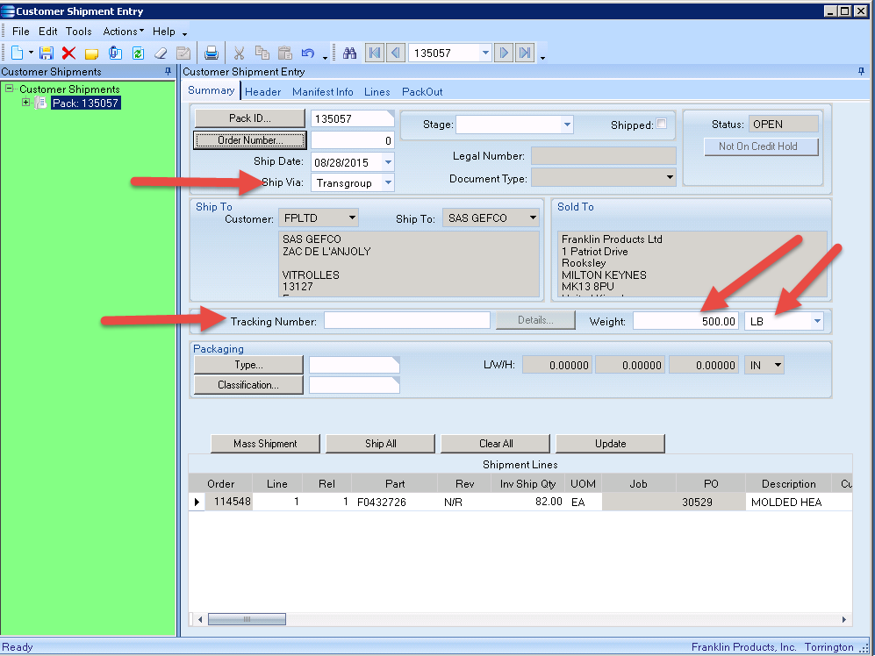
Required Fields in Customer Ship Entry (Main tab)

Slide 4
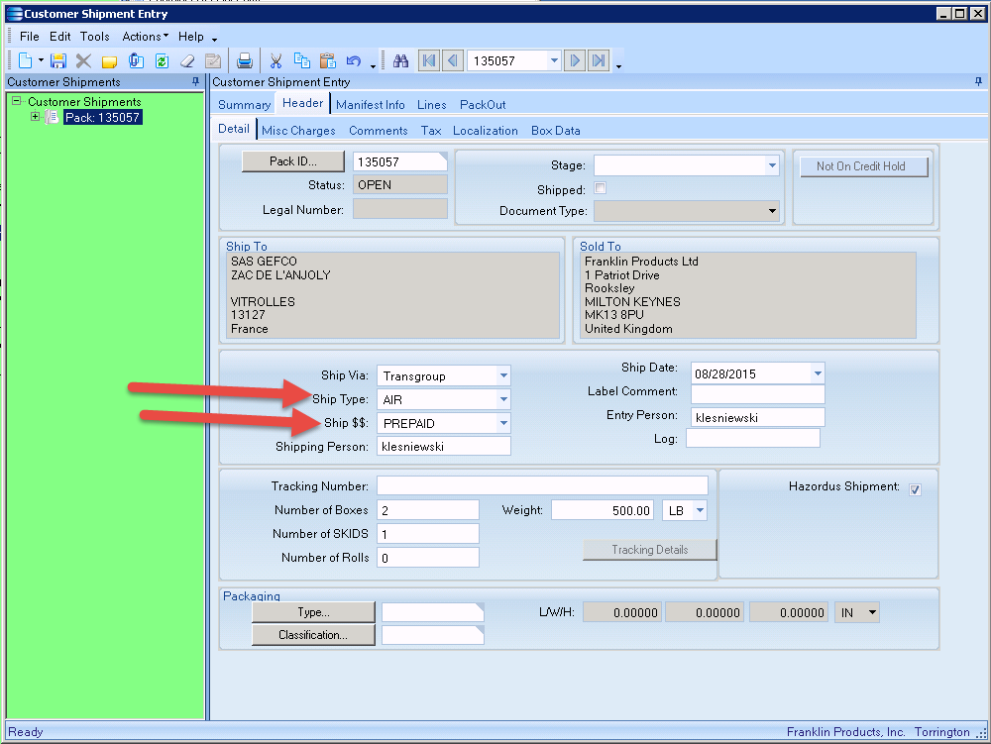
Required Fields in Customer Ship Entry (Header tab)

Slide 5
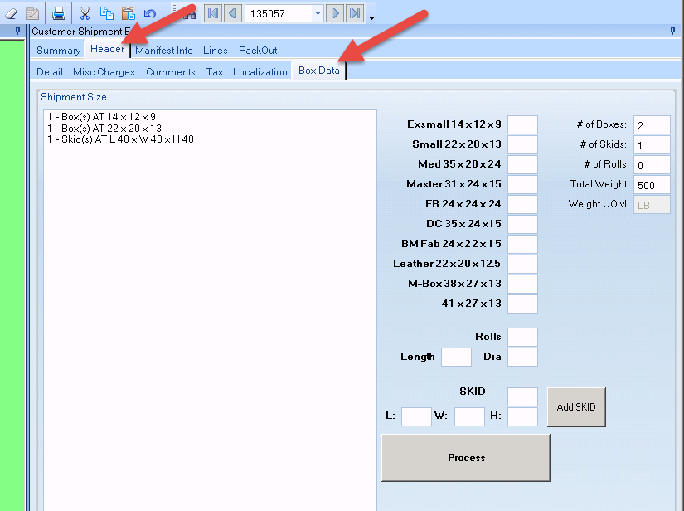
To Populate Box, Roll, Skid Info
Go to the Box Data Tab
Enter the correct QTY per box size.
Fill out the correct Data per Roll or Skid
Click the PROCESS button to update the main box
If needed enter multiple SKID data, and click the ADD SKID button.

Slide 6
Things to Note
Pressing the process button will overwrite/update the main box.
Click the ADD SKID button will add custom SKIDS
The BOX, ROLL, SKID qty will update based on this data

Slide 7
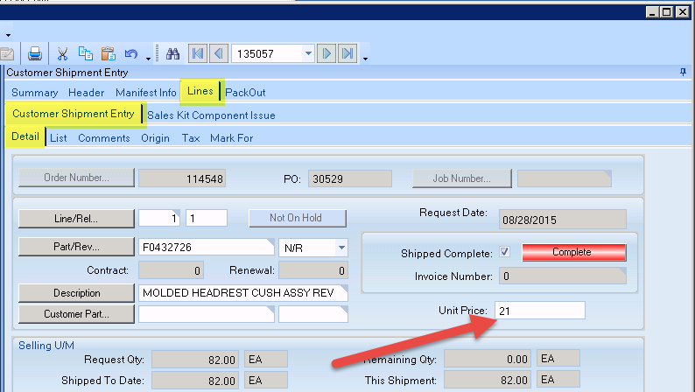
Pricing per line
The price will now update from the price book when ever a line is added to a Pack slip.
If there is no price in the price book it will populate a fixed price

Slide 8
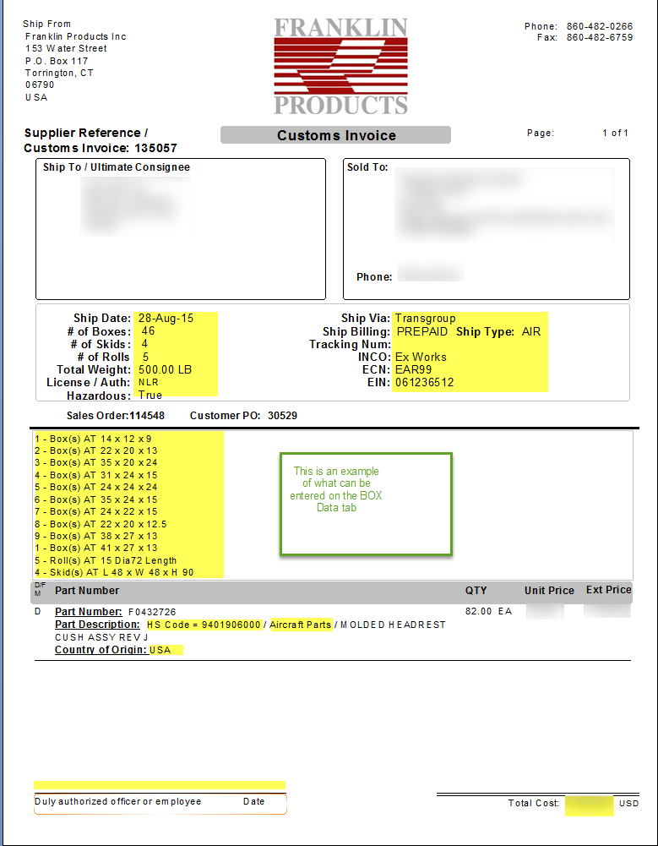
The Customs Invoice report
The customs Invoice has been updated to include all the data mentioned above.
Filling out the BOX Data tab will print in the center of the report.
All of the Roll, Skid and Box counts will update automatically with detentions.
The weight will now print on the report
The price will always have something, even if it’s a 0 cost PO/SO.
The Country of origin works off of the LOT number
The HS Code is pre built into the report.

